Slide 1
201A World Peace Summit
Iraq War — Through the Lens of Terrorism
L&P Institute
Presented by: Rosie Rong, Yingxin Lin, Tingwei Li

Slide 2
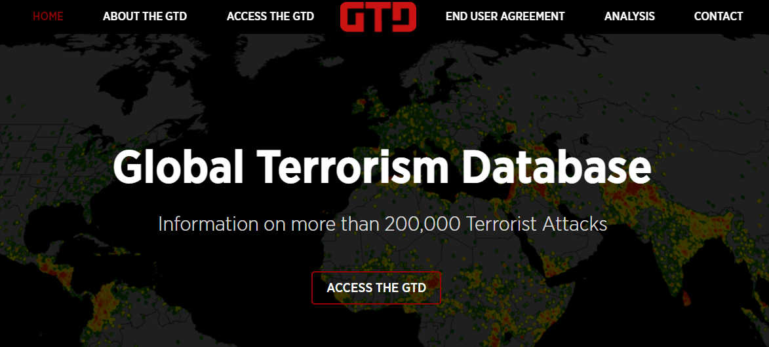
Dataset -The Global Terrorism Database(GTD)
Dataset obtained from Kaggle
GTD is developed and maintained by researchers at the National Consortium for the Study of Terrorism and Responses to Terrorism (START)
Headquartered at the University of Maryland
Data time range: 1970 - 2017
Data size: 18192 * 36

Slide 3
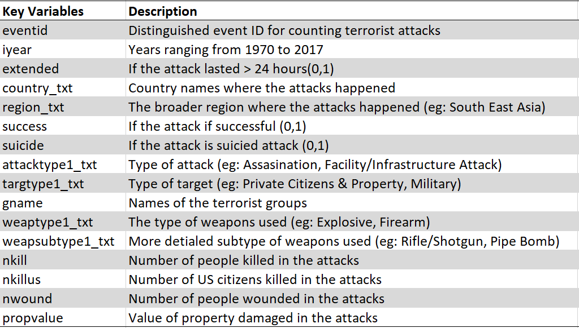
Dataset – Key Variables

Slide 4
Overview of Global and Iraq Terrorism

Slide 5
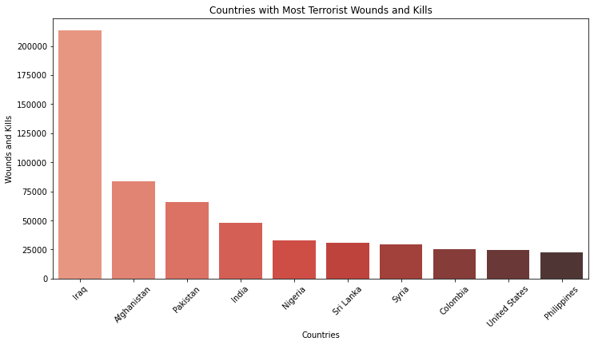
Which countries suffered the most from terrorism?

Slide 6
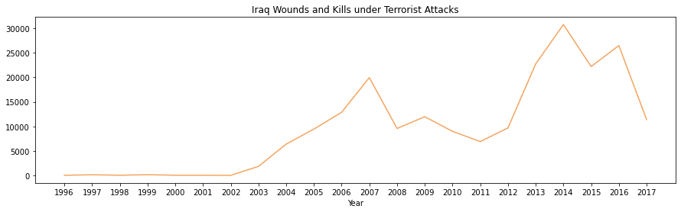
Timeline of War in Iraq
Iraq War by US
Iraq Domestic War
US started the invasion of Iraq
US retreated
US returned to halt ISIL

Slide 7
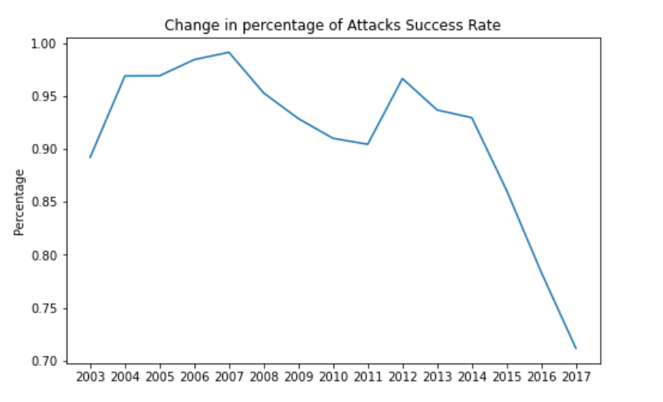
Success Rate of Attacks

Slide 8
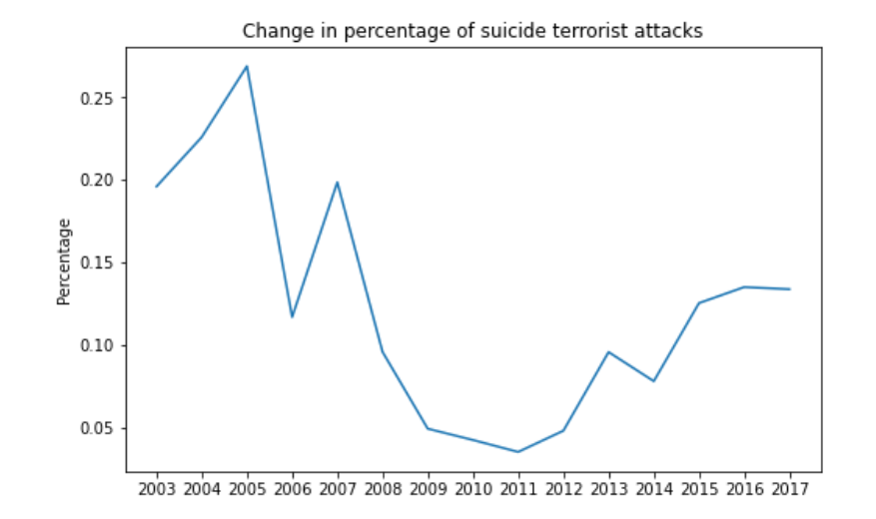
Suicide Attacks Percentage during Iraq War

Slide 9
Targets and Weapons

Slide 10
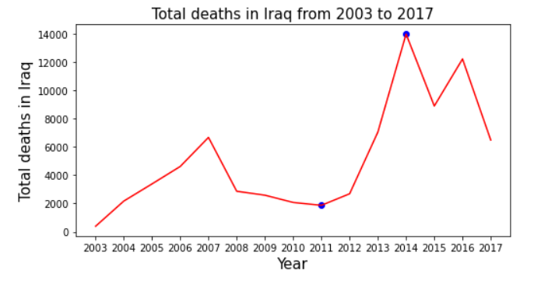
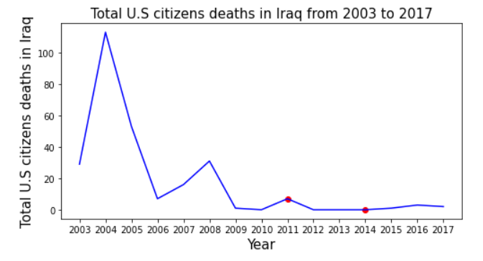
The Total Deaths vs Total US Citizens Deaths
US retreated
US returned
US retreated
US returned

Slide 11
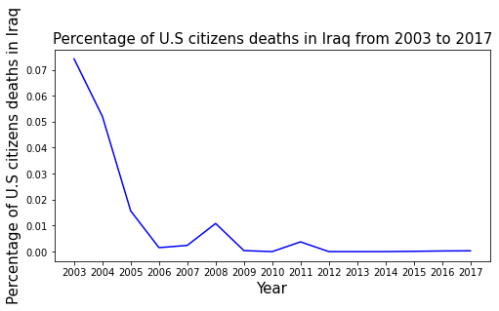
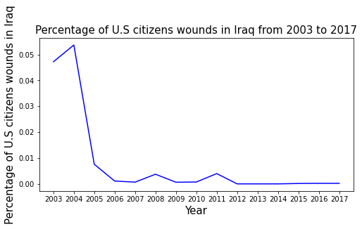
The Percentage of US citizens deaths to total deaths

Slide 12
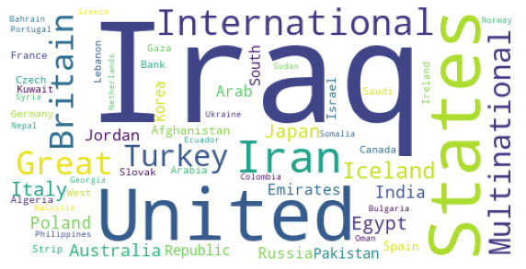
The nationality of the target that was attacked(2003-2011)
From 2003 to 2011, when the total number of deaths was relatively small, the nationalities of the targets are more diverse.

Slide 13
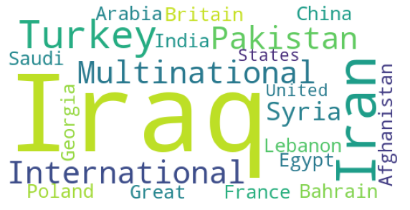
The nationality of the target that was attacked(2011-2014)
From 2011 to 2014, when the total number of deaths increased sharply, the diversity of the attacked targets’ nationality decreased slightly.

Slide 14
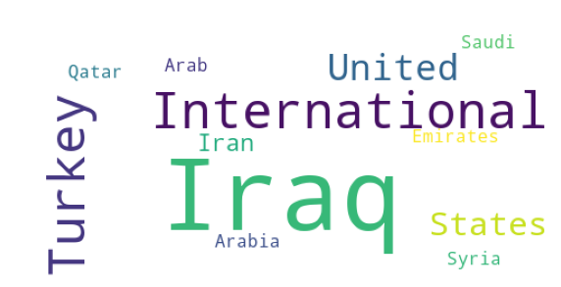
The nationality of the target that was attacked(2014-2017)
From 2014 to 2017, when the total number of deaths began to decrease, the national diversity of the attacked targets further decreased.

Slide 15
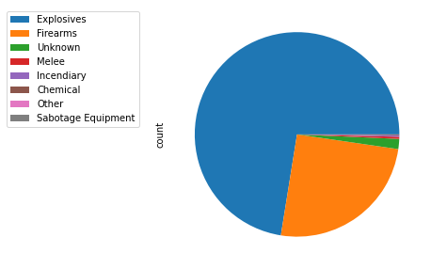
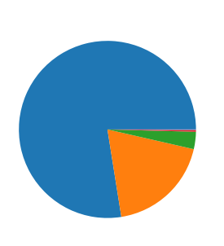
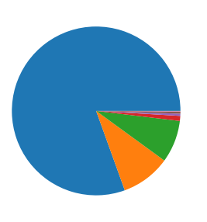
Changes in Weapon use
(2003-2011) (2011-2014) (2014-2017)
In each phase, the number of “Explosives” weapon types is always the most.

Slide 16
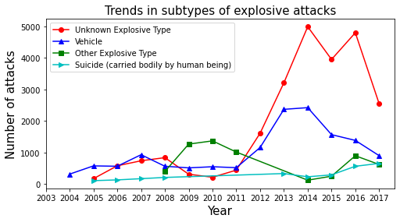
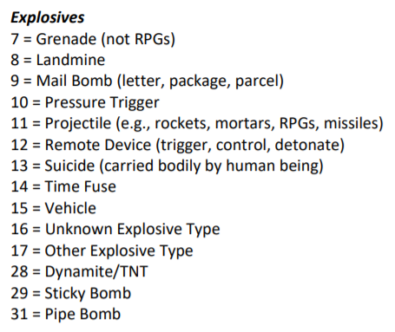
Trends in subtypes of explosive attacks
The explanation of Explosives’s subtypes is cited from “Global Terrorism Database Codebook”.

Slide 17
Terrorist Groups in Iraq

Slide 18
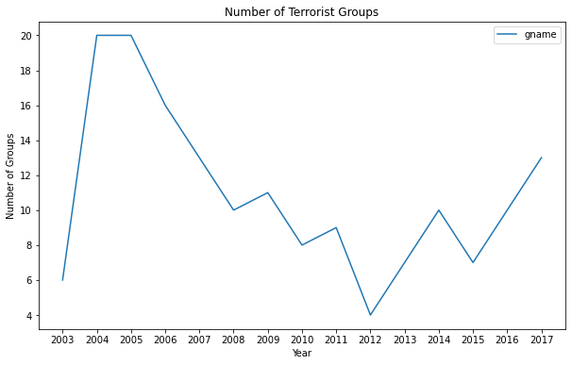
Terrorist Group Analysis
The US troop monitored elections and assisted the new central government to take control of cities from terrorists.
The local war in Iraq started. An increasing number of terrorist groups tried to take over cities from the central government.
Decrease
Increase

Slide 19
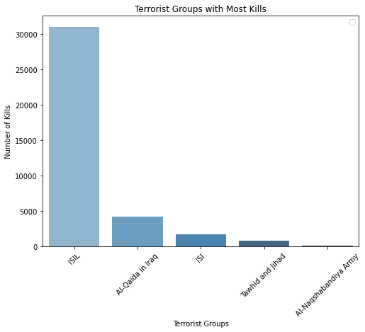
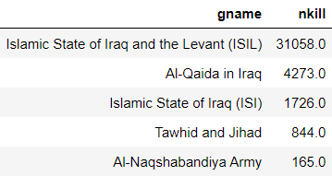
Top 5 Terrorist Groups
The terrorist groups with top 5 total kills :

Slide 20
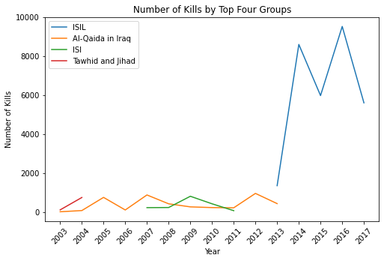
Terrorist
15 June 2014
U.S. President Barack Obama ordered United States forces enter to Iraq in response to ISIL.

Slide 21
Global Impact

Slide 22
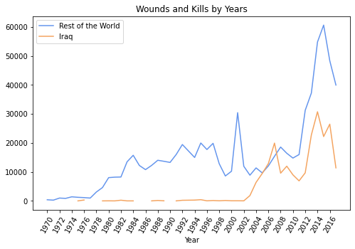
Iraq and Global Terrorist Attacks
2014
2003
2011
Terrorism casulty trend in the rest of the world shows similar patern as Iraq

Slide 23
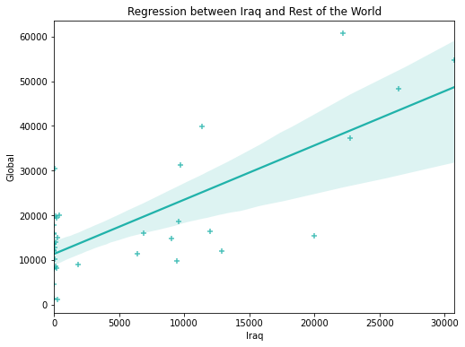
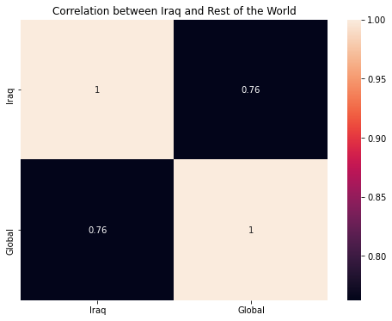
Correlation between Iraq and Global Casualty
The number of casualty in Iraq and the rest of the world shows high positive correlation
The Iraq war as an impact of the global terrorist attack activities
Qualification: There might be other wars that impact the global terrorist activities

Slide 24

Thank You for Listening
- Love and Peace -

Slide 25
Citation
[1] Global Terrorism Database Codebook https://www.start.umd.edu/gtd/downloads/Codebook.pdf
[2] Iraq War
https://en.wikipedia.org/wiki/Iraq_War
[3] War in Iraq (2013–2017)
https://en.wikipedia.org/wiki/Iraq_War

